Slide 1
Financial Modeling
Balance Sheets, Income Statements, Cash Flow Statements
Jacqueline Garner, Ph.D.
Lecturer
Scheller College of Business
Building Cash flow To Debtholders

Slide 2
Before We Begin…

Slide 3
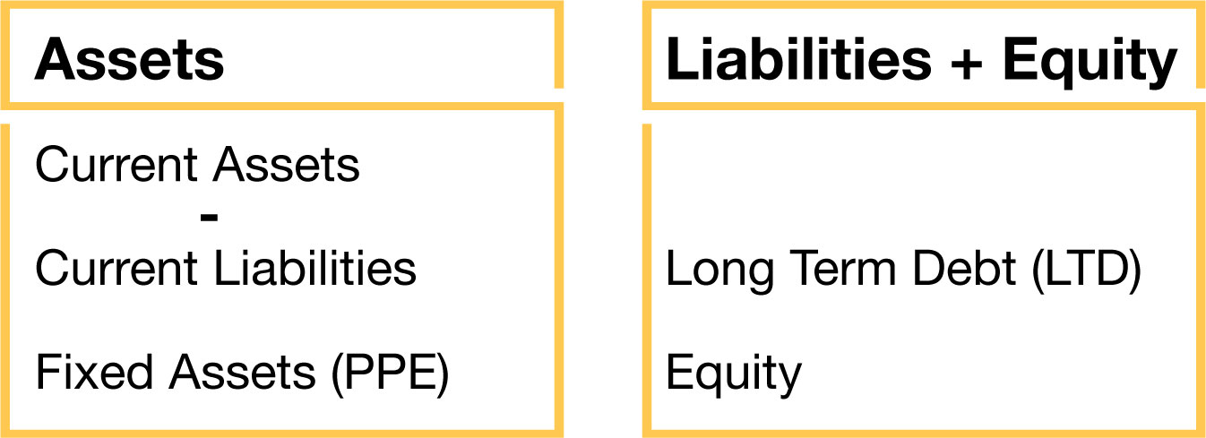
Balance sheet with CL netted against CA
We are now interested in the CFs TO the debtholders

Slide 4
Organization of Cash Flow to Debtholders
Cash Flow TO Debtholders
Plus interest (inflow)
Less net new debt (could be inflow or outflow)
Notes:
Note: Net new debt could be positive or negative. If it is positive, then that means debtholders gave the firm more debt, so when we subtract that, it’s an outflow for bond/debtholders. If “net new debt” is negative, that means debt went down, and when we subtract a negative number, the debtholders receive an inflow (because the firm paid debt off).

Slide 5
Example of Cash flow TO Debtholders
Let’s look at an example:
Please download the file named
“Balance_Sheets_Income_Statements_Example.xlsx”

Slide 6
Summary
Notes:
In this lesson, we demonstrated how to construct CF to bondholders also known as CF to debtholders. Thank you!

